Slide 1
Introduction to Classification for Machine Learning
Jake Marshall
Data Science Lecturer

Slide 2
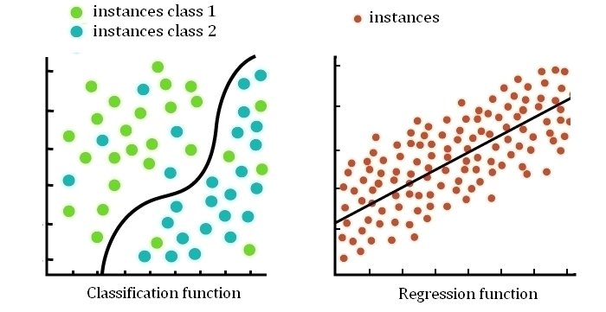
Reminder: What is Classification?
Classification is a supervised machine learning method where the model tries to predict the correct label of a given input data.
Notes:
The algorithm does this by finding the classification/decision boundary, which separates classes and helps inform the model on which class the points are labelled to.

Slide 3
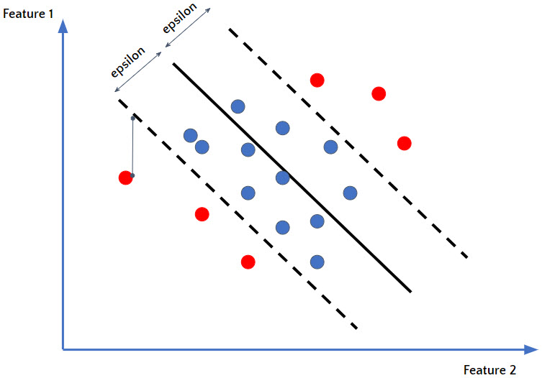
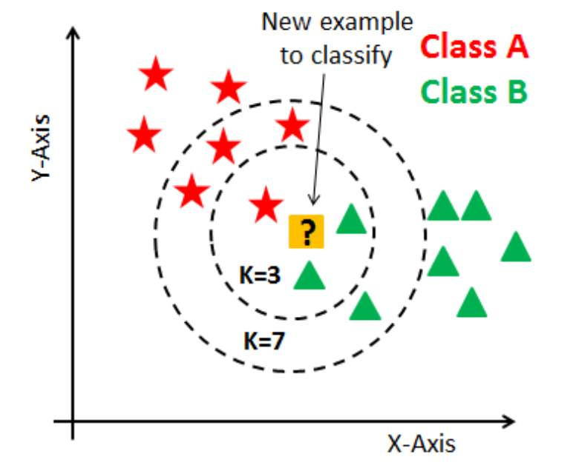
Examples of Classification Models
Logistic Regression
Support Vector Machine
Decision Trees
K-Nearest Neighbour

Slide 4

Decision Trees
If you’ve ever played Guess Who?, you’ve already experienced Decision Trees.
The aim is to identify the other players character by asking a series of questions.
Each question narrows down the possibilities, until finally we can identify the character with a guess.

Slide 5
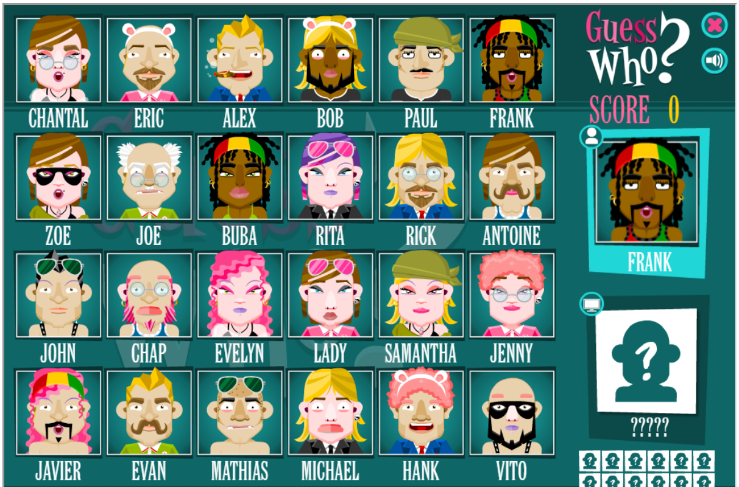
Let’s play a game!

Slide 6
Guess Who? – Example Questions
What yes/no question would you ask first?
Is your character male?
Is your character wearing glasses?
Does your character have a moustache?
Does your character have blonde hair?
Does your character have black hair?
Is your character bald?
Is your character wearing bunny ears?

Slide 7
Guess Who? – Optimising Questions
Asking if the character is male is the best first question, as it eliminates the most options.
There are multiple hair colours, and not all characters are wearing glasses on their face!
We could say that asking the characters sex results is the most Information Gain.

Slide 8
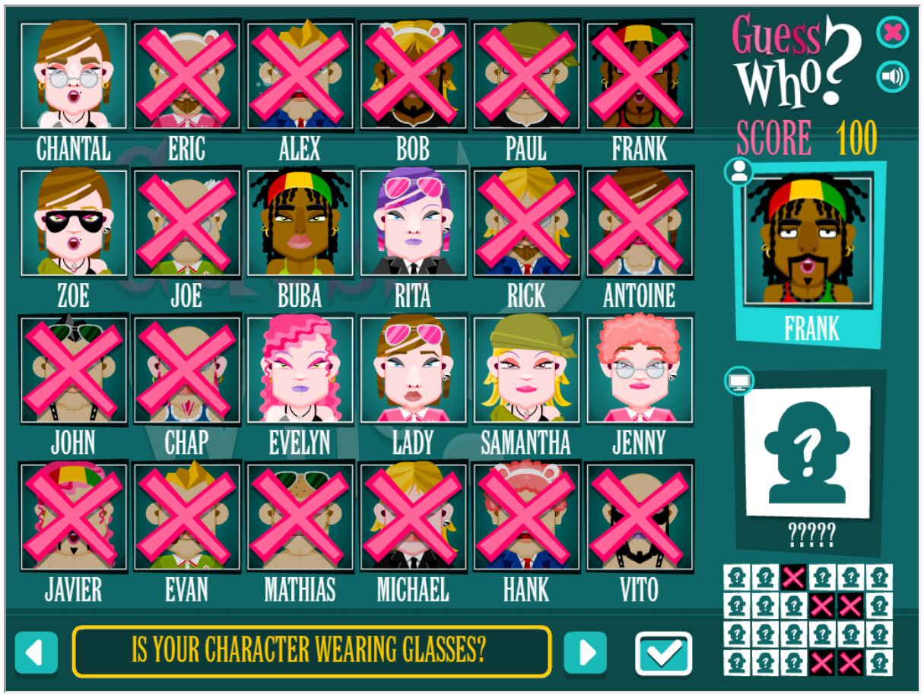
Guess Who? – Elimination Results

Slide 9
Guess Who? – Follow up questions
The results of the first question influence the next.
Some questions are now no longer useful:
Does your character have a beard?
Is your character bald?
The Information Gain from asking these questions is zero.

Slide 10
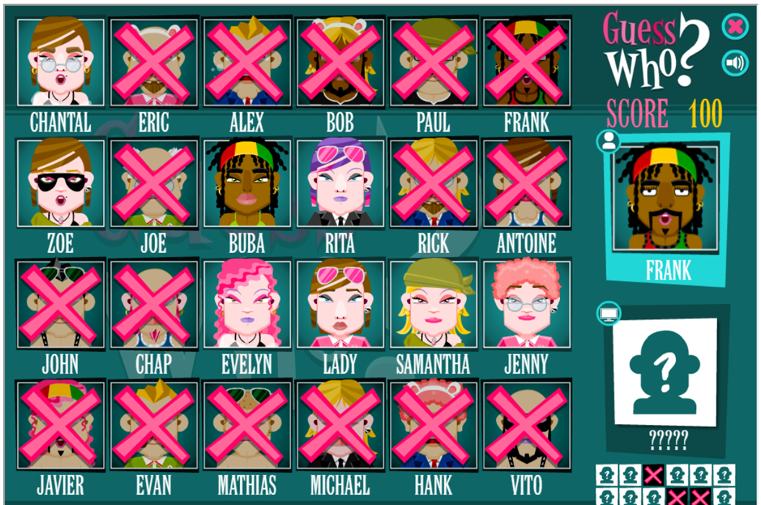
Guess Who? – Example sequence
Is the character male? No
Is the character wearing glasses? Yes
Does your character have brown hair? Yes
Is your Character wearing a necklace? No

Slide 11
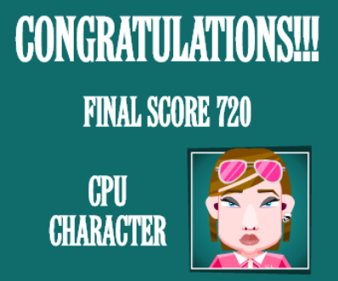
Guess Who? - LADY
However, at each step another question could’ve been asked.
Thus, leading to different characters dependent on the answers.

Slide 12
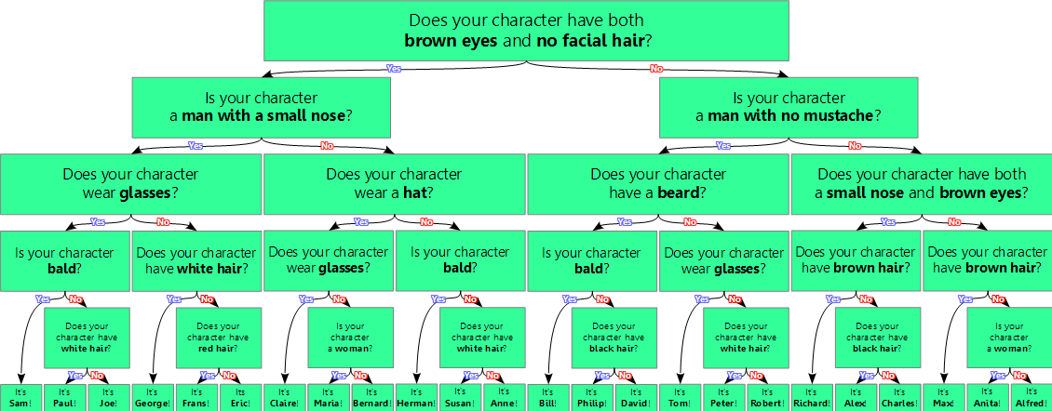
Guess Who? – Resulting Decision Tree
Notes:
Each step is effectively partitioning the dataset into different pools or categories, known as recursive partitioning.

Slide 13
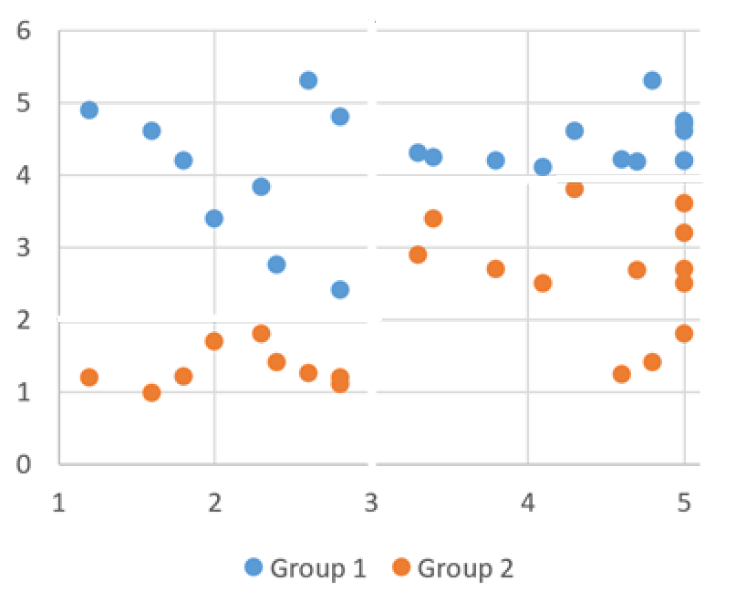
Another Decision Tree
Group 1 - people who are sad.
Group 2 - people who are happy.
We would like to predict whether a person is happy or sad.
Using number of days worked and number of days spent on hobbies as features.
Number of days worked
Number of days spent doing a hobby

Slide 14
Example – Initial ideas
What yes or no questions would you ask to determine if someone is happy or sad?
Number of days worked
Number of days spent doing a hobby

Slide 15
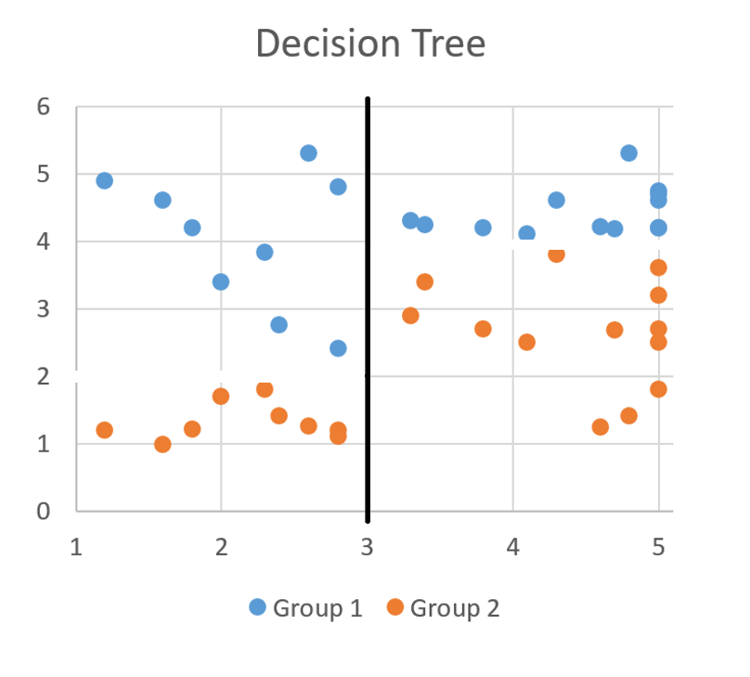
Example Question
Question 1:
Do you spend less than 3 Days doing a hobby?
Asking this Question marks this line, and depending on the answer, we fall on one side of the plane.
Number of days worked
Number of days spent doing a hobby

Slide 16
More Example Questions
Question 2:
What would you ask if I said yes?
Question 3:
What would you ask if I said no?
Number of days worked
Number of days spent doing a hobby

Slide 17
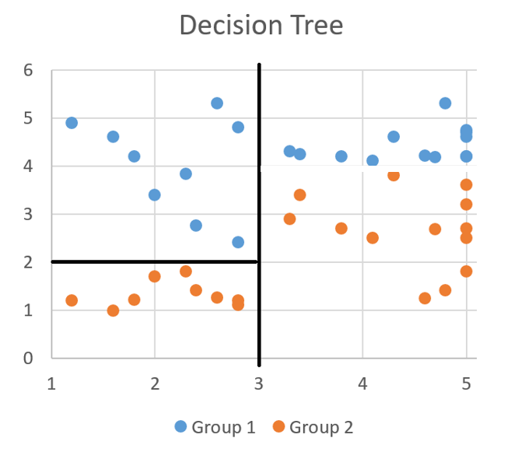
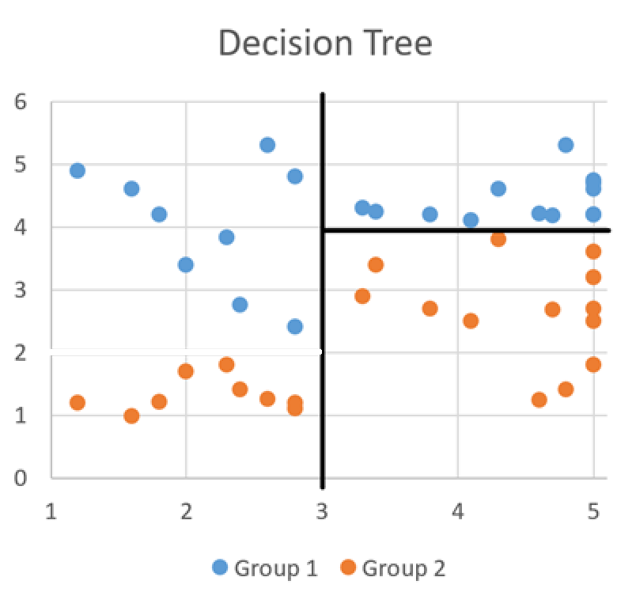
Results of the Example Questions
Question 2 : What would you ask if I said yes?
Question 3: What would you ask if I said no?
Notes:
How do we write this in a way other than a graph?

Slide 18
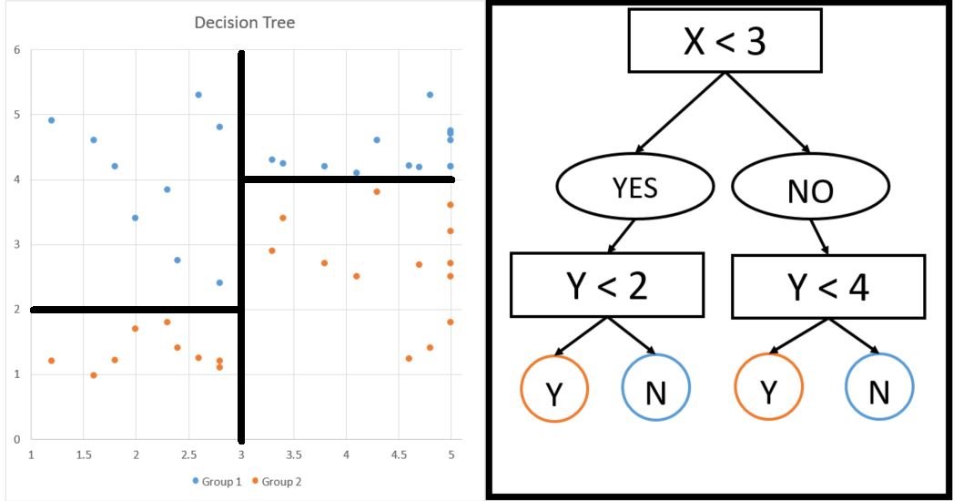
Visualising as an algorithm
X – is the number days spent doing a hobby.
Y – is the number of days spent in work.
Do you think we could use the model to classify if they are happy or sad?
Notes:
We could use some additional data to ensure our sample is representative of the sample we are going to make conclusions about

Slide 19
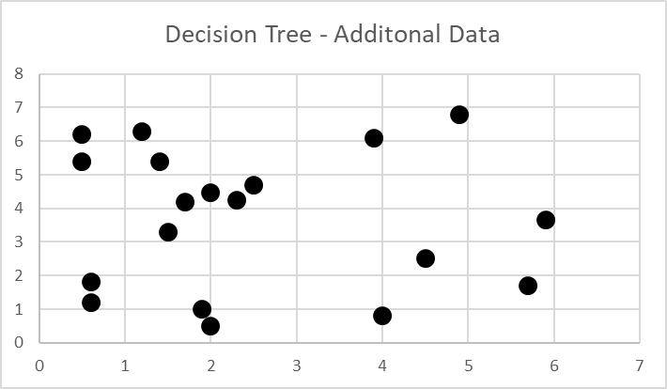
Additional data
For some additional data, collected in the same way, can our model predict if these people were happy or sad?
Y Axis – Number of Days worked
X Axis – Number of Days spent doing a hobby

Slide 20
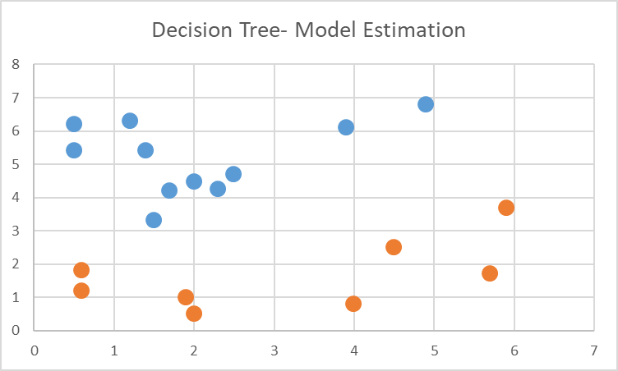
Classifying with our model
Our model would draw the following decision lines.
Y Axis – Number of Days worked
X Axis – Number of Days spent doing a hobby

Slide 21
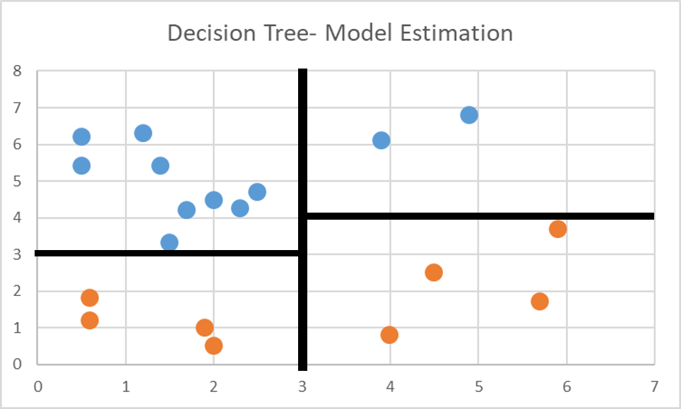
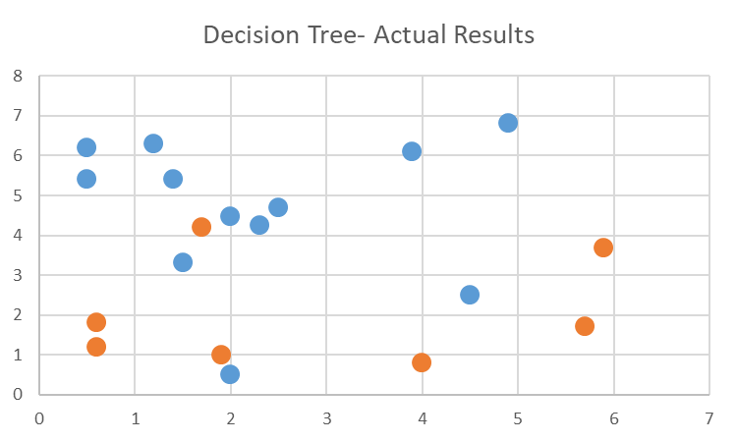
Predictions vs. Actual
Predictions from our model.
Ground truth classifications.

Slide 22
Conclusions from additional data
Model correctly classifies a high percentage of data points with the features used.
It does misclassify some cases:
These could just be anomalies in the data.
If there were more points with this combination of feature values, the model may learn better how to differentiate them.
If more features were collected, i.e. age, days with friends, financial situation etc, then perhaps the model would perform better.
How do we measure this performance?

Slide 23
The Confusion Matrix
Plots predicted vs. actual values, with a positive and negative set up for whether these were correctly predicted or not.
This counts the key values needed to compute our metrics:
True Positive – Predicted positive and actually positive.
False Positive – Predicted positive but actually negative.
True Negative – Predicted negative and actually negative.
False Negative – Predicted negative but actually positive.
Notes:
Summary table for calculating the successful classification of our models.

Slide 24
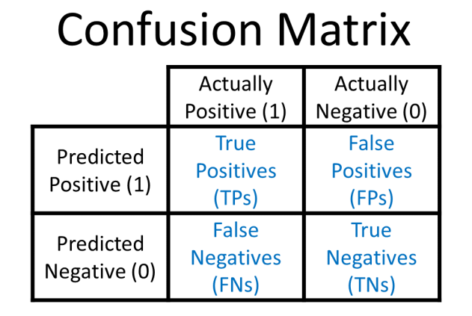
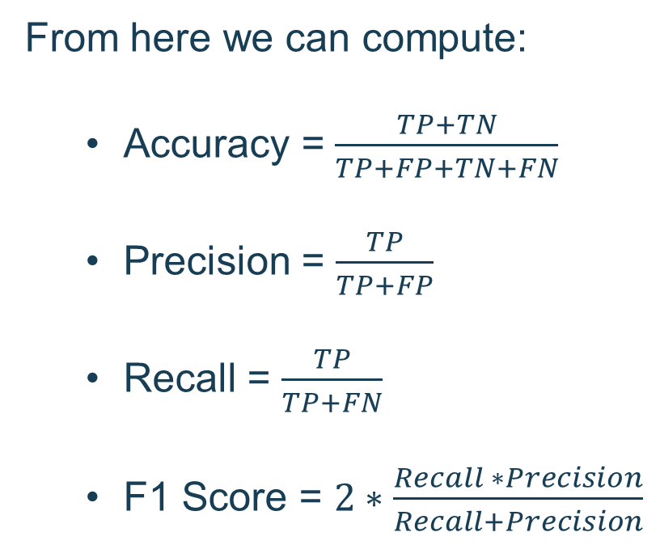
Metrics derive from this table
From here we can compute:
Accuracy = $\frac{TP+TN}{TP+FP+TN+FN}$
Precision = $\frac{TP}{TP+FP}$
Recall = $\frac{TP}{TP+FN}$
F1 Score = $2∗\frac{Recall ∗Precision}{Recall+Precision}$

Slide 25
Let’s break these down!
Accuracy - how well the model performed in general.
Precision - how well the model predicted the positive classes.
Recall - how well the model was able to identify positive classes during prediction.
F1 Score – Weighted average of precision and recall to account for both.
Notes:
What do we think is the core problem with accuracy as a metric? Think of the class distribution….

Slide 26
Precision and Recall Trade-off
Real world datasets are almost never class balanced.
Accuracy therefore does not give a true picture of the model's performance.
Precision and Recall help but each miss either false positives and false negatives, requiring a decision.
Are false positives worse than false positives? Depends on the context e.g. health.
F1 Score attempts to capture both patterns with a weighted average.
Notes:
Accuracy weights predictions of positive and negative classes the same (as it is assuming balance), but this is rarely ever the case

Slide 27
Metrics for Feature Importance
One of the best things about Decision Trees is they allow for some light feature selection via the Information Gain metric.
This value is derived from another factor, Entropy.
Entropy is a measure of on average, how many questions we would need to ask to predict a result, multiplied by the probability of each specific result occurring.

Slide 28
Entropy
Entropy in a sense measures the randomness of an event.
Suppose I picked a character, and you randomly guessed who it was.
This would have an entropy of 1 (completely random) as the guess wasn’t based off any information.
Suppose you wanted to guess my character, but knew he had short blonde hair and was wearing a suit.
The Entropy would be 0, as you would be certain of the outcome (Alex).

Slide 29
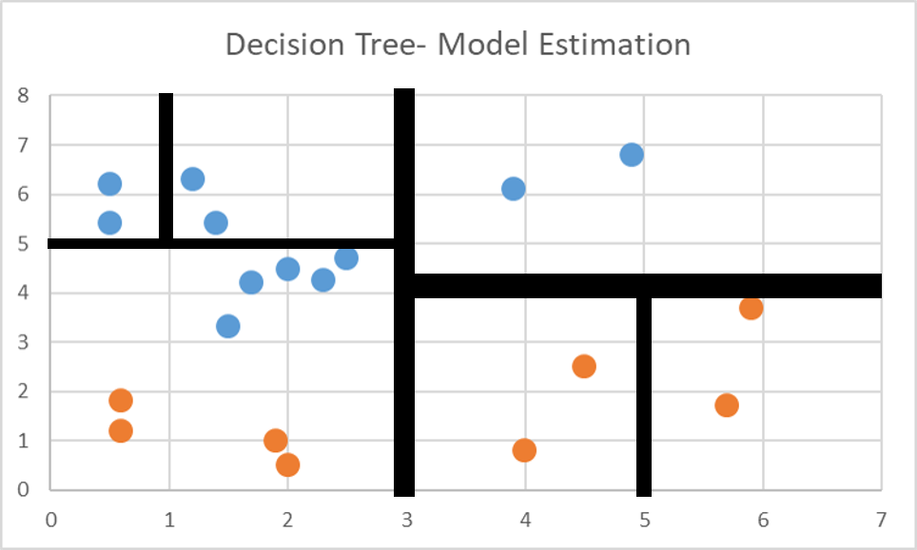
Differences in Entropy
High Entropy
Decision Trees that aim to have lower Entropy aim to ask less questions to solve the problem.
While both models here have the same accuracy, one has a much higher entropy.
This leads to overfitting, a key problem with these models.
Low Entropy

Slide 30
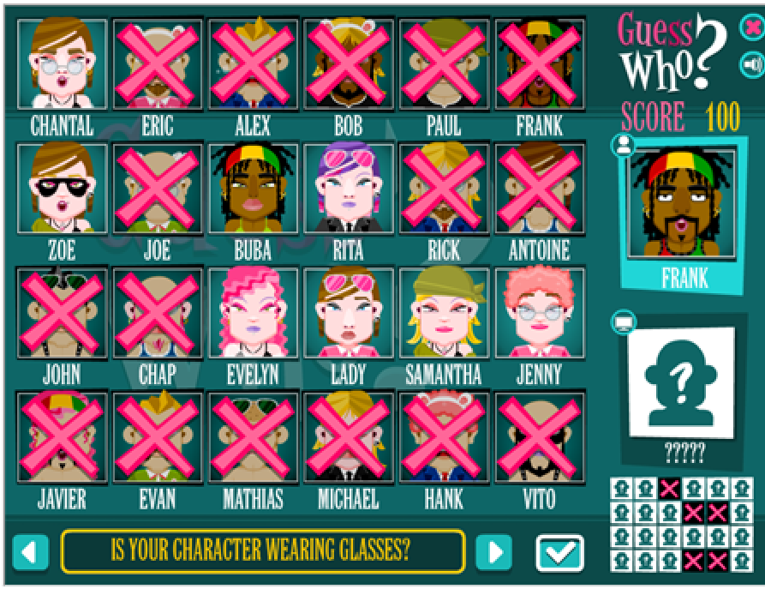
Information Gain
Information Gain determines how useful a feature is at determining the class label.
This takes entropy into account.
For example:
Whether there is a beard has 0 information gain as none have a beard.
If information results in absolute certainty (pink hair for Evelyn), this will have information gain 1.
Notes:
This can help you choose between features when narrowing down to the simplest model you can.

Slide 31
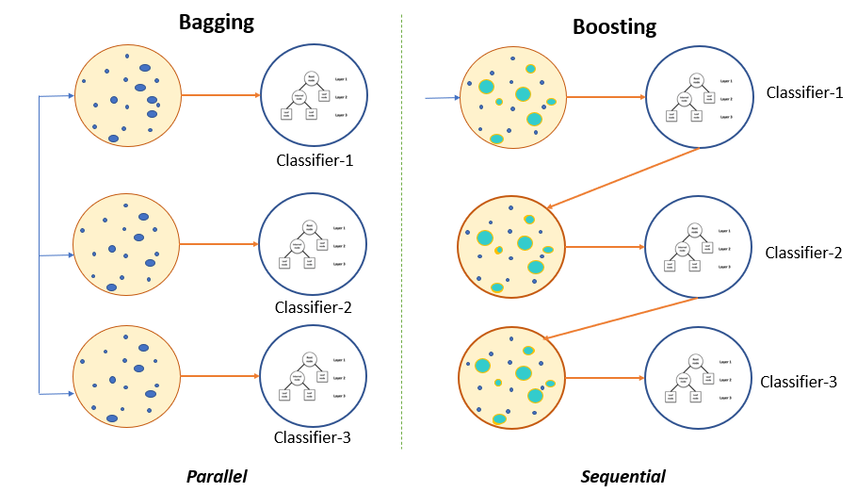
Bagging & Boosting
Bagging and Boosting successfully improve on standard Decision Tree’s and are known as ensemble methods.
This leads us to the hugely popular Random Forest model.
Notes:
Ensemble learning gives credence to the idea of the “wisdom of crowds,” which suggests that the decision-making of a larger group of people is typically better than that of an individual expert (IBM 2023

Slide 32
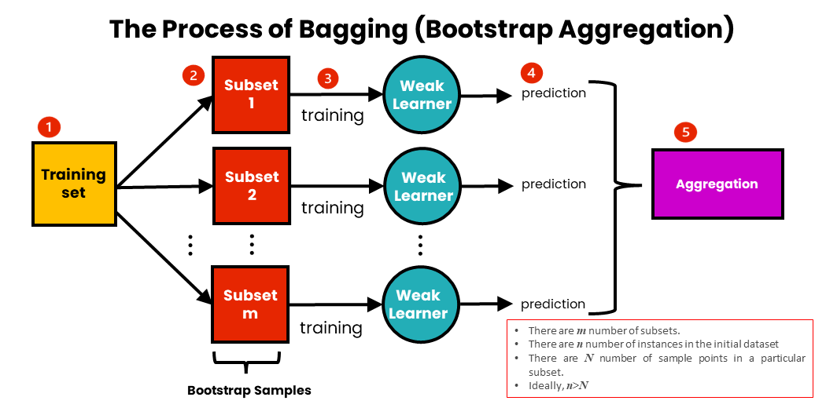
Bagging
T sets of the data are made, where each contains randomly selected samples with replacement, known as bootstrapping.
These sets are then trained in parallel with weak or base learners (with no tuning).
An average or majority is then taken to compute a more accurate estimate overall.
Notes:
In the case of classification, the average is simply the majority vote!

Slide 33
Bagging Example
Suppose we have a training set of the following:
Training Set
Trial 1
Trial 2
Trial 3
With T = 3:

Slide 34
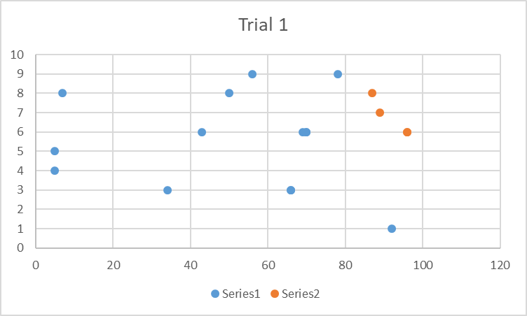
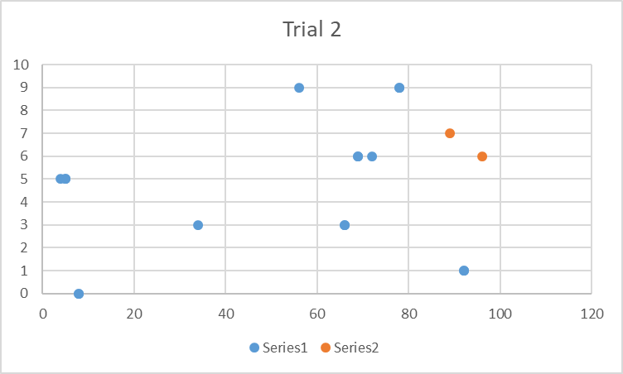
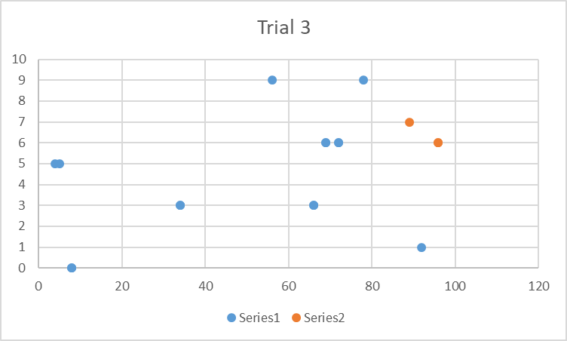
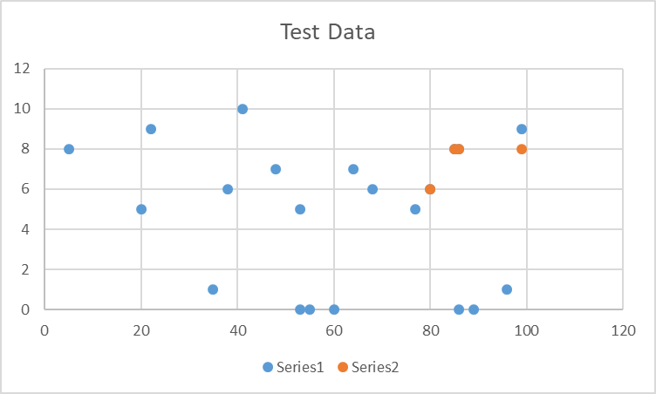
Now create the weak Trees!
Each trial votes where they believe a certain data point belongs.
The majority vote wins in the aggregation stage.

Slide 35
Evaluation of Bagging
Easy to implement.
Helps reduce variance in a machine learning algorithm.
Difficult to interpret
Expensive as datasets grow.

Slide 36
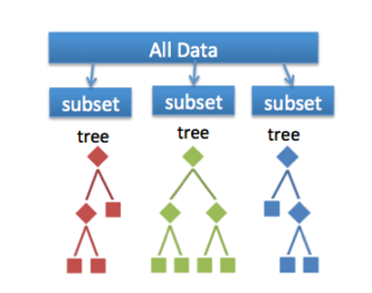
Random Forest
The idea is if one tree is good then many are better.
In addition to each trial using a subset of the data points/rows, it also operates on a subset of the variables, at each split.
The output of the forest is the majority vote for the classification.

Slide 37
Random Forest with GuessWho?
For your first guess, a Random Forest would subset questions randomly so that you can only ask a few, say:
Is your character bald?
Is your character wearing glasses?
Do they have a moustache?
You would then ask the best question out of these three.
For the second iteration, the random sample may be:
Is your character wearing bunny ears?
Do they have black hair?
Are they male?
And again, you would ask the best question.

Slide 38
Random Forest - Rationale
This sounds counter intuitive but over thousands of iterations, with each of them voting, achieves several things:
Identifies more difficult trends within the data.
Avoids overfitting as the model is more random and generalisable
Doesn’t heavily bias against a small group.

Slide 39
Boosting
Boosting is similar, but allows models to learn sequentially, as opposed to in parallel.
Series of models made and with each iteration, misclassified data is penalised more.
This helps combat noise in data that leads to high bias.
Examples include Adaboost, XGBoost and GradientBoost.

Slide 40
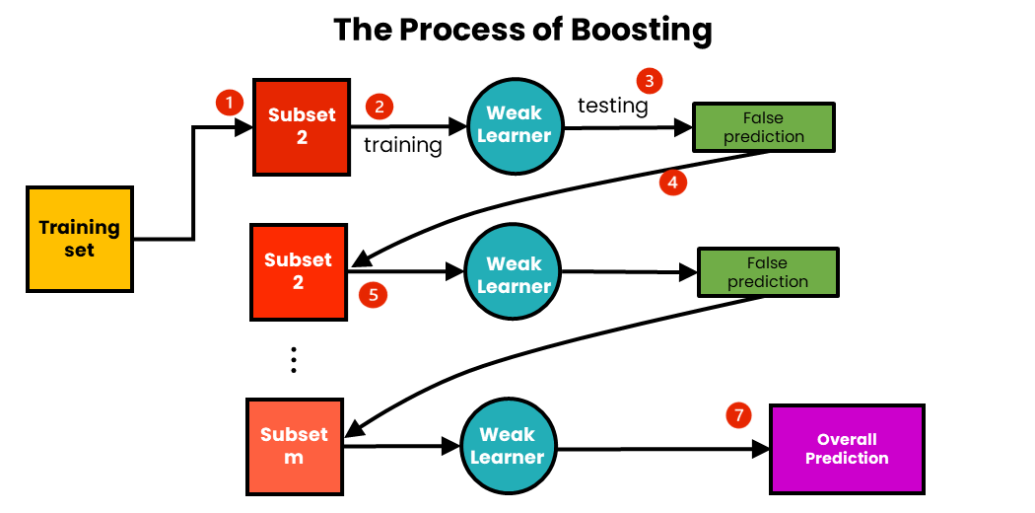
Visualising Boosting
Incredibly powerful but can accentuate overfitting, as it learns the “quirks” of the data.
Sometimes seen as overkill for less complicated prediction problems.
Harder to deploy and maintain.

Slide 41
Resources
Iris Dataset | Kaggle
https://www.w3schools.com/python/python_ml_getting_started.asp
https://machinelearningmastery.com/start-here/
Titanic - Machine Learning from Disaster | Kaggle

Slide 42
Questions?

